Slide 1

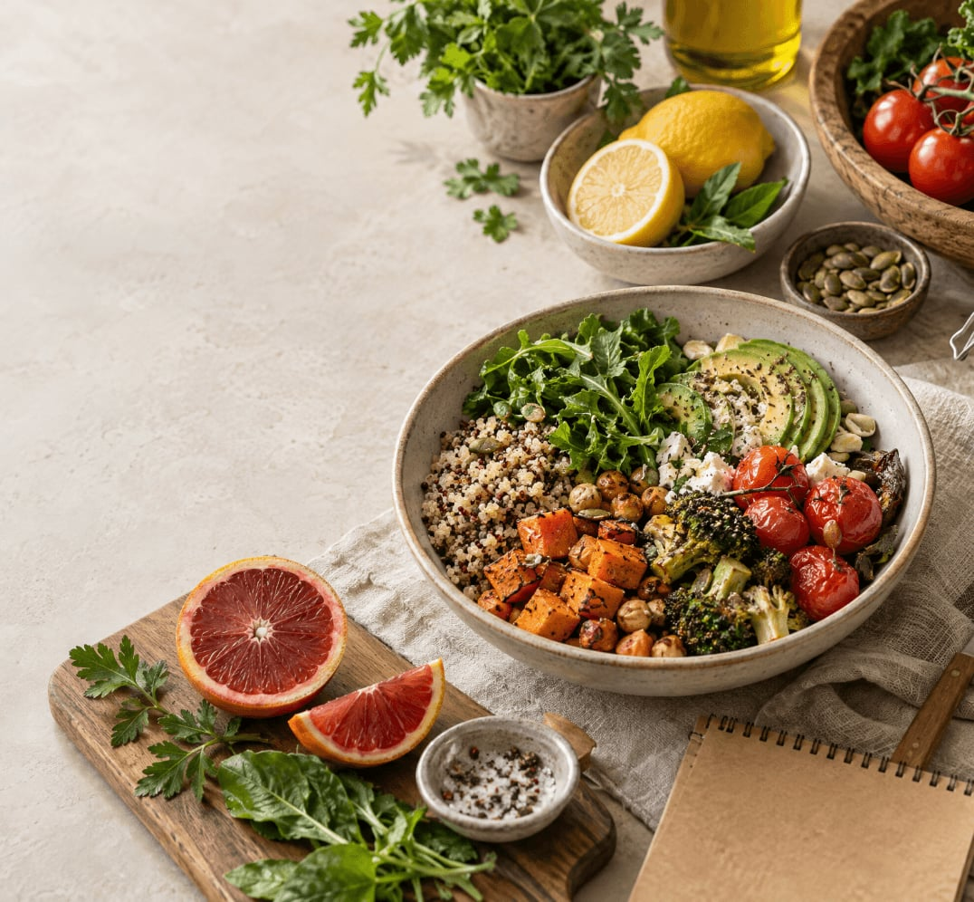
JAVA PROGRAMMING PROJECT
Weekly Meal Plan & Grocery Generator
A practical Java project that turns meal preferences into a thoughtfully organized weekly menu and shopping list.
{ 1 }

Slide 2

Presented by:
Nikhil Srivatsa
2620090029
Sai Hitesh
2620030269
Sai Thanush
2620040075
{ 2 }

Slide 3

Abstract
This project introduces an automated nutrition and shopping system designed to eliminate meal-planning fatigue. By leveraging foundational Java modules, the application processes user-defined calorie goals and dietary constraints to generate a structured seven-day plan.
The system utilizes object-oriented design for recipe management, modern File I/O for data persistence, and functional streams for real-time reporting. The final deliverable is an integrated console-based application that outputs consolidated grocery lists and daily meal schedules tailored to individual needs.
{ 3 }

Slide 4
The Problem & Project Goal
User Challenges
System Solution
Decision fatigue in daily meal selection
Algorithmic meal plan generation
Manual grocery list compilation leading to errors
Automated, consolidated shopping lists
Inconsistent nutritional tracking
Recipe data persistence and retrieval
Food waste from uncoordinated shopping
Constraint-based planning (dietary/budget)
{ 4 }

Slide 5

From Preferences to a Weekly Plan
01
02
03
Input
Process
Output
Dietary preferences, calorie targets, and available pantry items.
Algorithm selects recipes and scales portions for the week.
A structured 7-day meal calendar and a categorized grocery list.
{ 5 }

Slide 6
Putting it Together · Demo & Learning Outcomes
Architecture
Example Flow
Evidence of Learning
Controller: User interaction logic
1. Load recipe library from disk
Functional use of Streams & APIs
Service: Planning & Grocery logic
2. Scan user calorie/diet inputs
Robust OOP design principles
Repository: File-based recipe storage
3. Execute generation algorithm
Efficient memory management
Domain: Recipe & Meal Plan models
4. Export plan to text report
Practical error handling
Final Deliverable: Integrated Java Application providing a seamless Meal Planning experience.
{ 12 }

Slide 7
CO1 · Computational Thinking & Java Foundations
Problem Solving & Logic
EXAMPLE · READ USER INPUT
Break the meal-planning task into clear steps: collect preferences, select meals, and generate a weekly plan.
Scanner sc = new Scanner(System.in);
System.out.print("Number of people: ");
int people = sc.nextInt();
System.out.print("Food preference (1-3): ");
int preference = sc.nextInt();
System.out.printf("People: %d%n", people);
Data Types & Variables
Represent people and menu choices with integers, grocery quantities and prices with decimal values, and preferences with text or Boolean values.
Console Input & Output
Read the user's choices and display the weekly plan and grocery-cost summary in a clear format.
{ 1 }

Slide 8
CO2 · Control Flow: Selection & Iteration
Conditional Selection
EXAMPLE · VALIDATE A MENU CHOICE
Choose vegetarian, non-vegetarian, or mixed menus by checking the user's preference.
while (true) {
System.out.print("Breakfast choice: ");
int choice = sc.nextInt();
if (choice >= 1 && choice <= menu.size()) {
break;
}
System.out.println("Invalid choice!");
}
Input Validation
Check that entered choices fall within the allowed range before accepting them.
Loops & Repetition
Repeat the meal-selection process for each day of the week and keep asking until input is valid.
{ 2 }

Slide 9
CO3 · Methods, Decomposition & Arrays
Modular Programming
EXAMPLE · PROCESS ALL DAYS
Separate tasks into methods so menu creation, input validation, ingredient calculation, and printing can be managed independently.
String[] days = {"Monday", "Tuesday",
"Wednesday", "Thursday", "Friday",
"Saturday", "Sunday"};
for (int i = 0; i < 7; i++) {
System.out.println(days[i] + ":");
// Read meal choices for the day
}
Methods & Parameters
Pass meal names and the number of people to methods that calculate the required ingredients.
Arrays & Traversal
Store the days of the week and selected meals, then process each day's breakfast, lunch, and dinner.
{ 3 }

Slide 10
CO4 · Object-Oriented Modelling & Design
Classes & Objects
EXAMPLE · MAP-BASED GROCERY DATA
Use a class to organize the meal planner's data and operations, and objects to work with Java library types.
Map<String, Double> prices =
new HashMap<>();
prices.put("Rice (kg)", 60.0);
prices.put("Paneer (kg)", 350.0);
Map<String, Double> groceryList =
new TreeMap<>();
groceryList.put("Rice (kg)", 1.2);
Static Members & Methods
Share common program data and utility methods across the meal-planning workflow.
Interfaces & Implementations
Use the Map interface with implementations such as HashMap and TreeMap to organize grocery data.
{ 4 }

Slide 11
CO5 · Strings, Library Algorithms & Text Processing
String Processing
EXAMPLE · IDENTIFY INGREDIENTS
Inspect meal names to identify ingredients and decide which grocery items should be added.
String meal = selectedMeal.toLowerCase();
if (meal.contains("paneer")) {
addItem("Paneer (kg)",
0.10 * people);
}
System.out.printf("%-20s Rs. %.2f%n",
item, cost);
Searching & Formatting
Search text with string methods and format quantities, prices, and totals into readable columns.
Sorted Output
Keep grocery items alphabetically ordered by using a TreeMap, making the combined list easier to read.
{ 5 }

Slide 12
CO6 · Collections & Data Management
Collections Framework
EXAMPLE · COMBINE GROCERY QUANTITIES
Store menu options in resizable lists and maintain grocery quantities and prices as key-value pairs.
static void addItem(String item,
double quantity) {
groceryList.put(item,
groceryList.getOrDefault(item, 0.0)
+ quantity);
}
for (Map.Entry<String, Double> entry
: groceryList.entrySet()) {
// Calculate each item's cost
}
Generics & Type Safety
Specify types such as ArrayList<String> and Map<String, Double> to reduce accidental type errors.
Iteration & Aggregation
Traverse grocery entries, combine repeated ingredients, and calculate the total shopping cost.
{ 6 }

